Slide 1



FOREIGN EXCHANGE RATES PREDICTION
JUNE 24, 2023

Slide 2



TEAM TENSORFLOW
AANU OGUNDIRAN | UDO ANIEKAN
MICHELLE JULIET | ODUNOLA AKIMU
OLATUNBOSUN VICTOR | FACHI OKOLO
CHUKWUNEDUM EZEKWEM | CHUKWUNEDUM EZEKWEM
Other Active Members
CYNTHIA NJAU
Role: Presenter 1
OLADOTUN USIOLA
Role: Presenter 2
Project Lead: OLADOTUN USIOLA
Assistant Project Lead: OLUWATOMISIN AROKODARE
Query Analyst: OSUNDARE SEYI

Slide 3
PROBLEM STATEMENT
The climbing rates of international and financial developments have been pegged to the exchange rate for some time now. Therefore, understanding and accurately forecasting the foreign exchange rates is crucial especially for businesses, investors, and policymakers for economic growth.
Therefore, the aim of this project is to:
To identify underlying patterns such as trend, seasonality, and cyclicity that may exist in the data (using China - Yuan per US Dollar as a case study).
To forecast and/or predict future value rates of China - Yuan per USD.
To compare and evaluate the actual rates of this currency with the forecasted value rates.
Build a function that can forecast and evaluate any foreign exchange currency rate present in the data.

Slide 4
EXISTING SOLUTIONS
Time series models: These models capture the temporal dependencies and historical patterns in exchange rate data.
Regression models: These models can help identify the factors that have a significant impact on exchange rate movements.
Artificial Neural Networks (ANN) Neural networks, including feedforward and recurrent architectures, have been utilized for exchange rate prediction
Support Vector Machines (SVM) is a popular machine learning algorithm used for exchange rate prediction
Deep learning models: These models can capture temporal dependencies and handle sequential data effectively.

Slide 5
OUR APPROACH
This project explored various perceptions such as:
Restructuring the dataset for time series analysis.
Selecting three commonly used model for time series training and selecting a model with the best performance.
Creating several functions for code reusability for different currencies in the dataset.

Slide 6

DATASET DESCRIPTION
The dataset was generated from the Federal Reserve's Download Data Program by Bruno Luiz Ferreira and was obtained via kaggle.
Bruno, however, made some changes in the dataset such as header simplifications and inversions of base currency to dollar.
The dataset focuses on foreign exchange rates from 2000 to 2019, featuring 22 different currency exchange rate such as the Austrailian Dollar per USD, British pounds per USD, Candian dollars to USD, among many others.

Slide 7
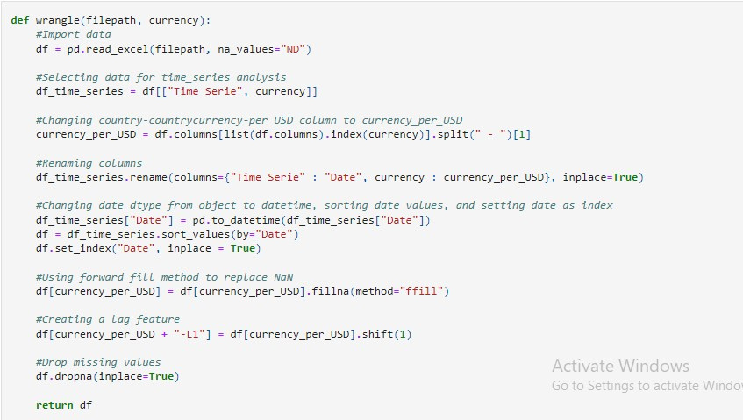

DATA WRANGLING (Linear Regr)

Slide 8
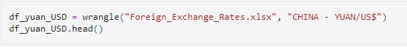
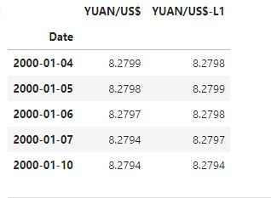
DATA WRANGLING (Linear Regr)

Slide 9
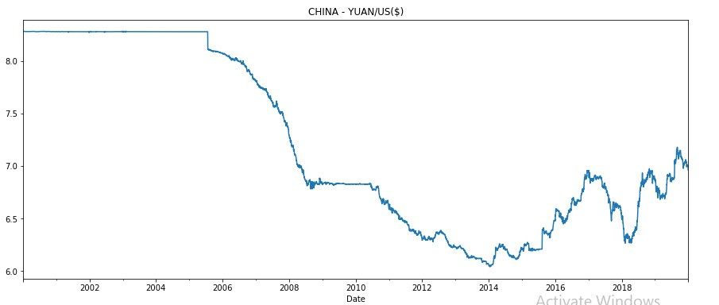
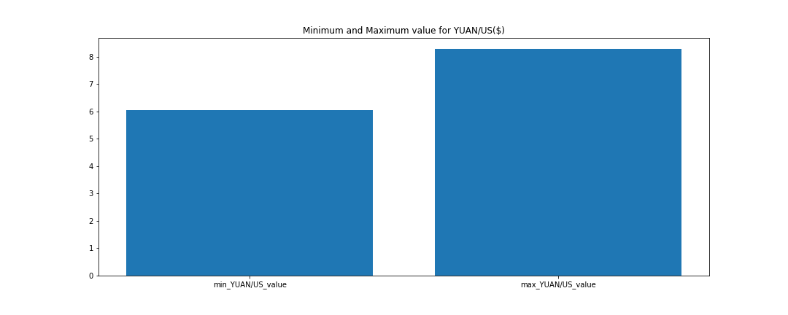
EXPLORATORY DATA ANALYSIS
The line plot shows the China - Yuan/US Dollar trend.
The bar chart, however, shows the minimum and maximum value of the Yuan/US pair over the years (2000 to 2019).

Slide 10
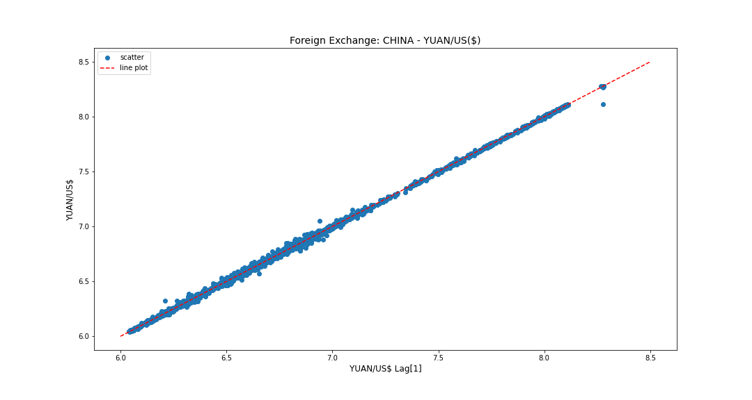
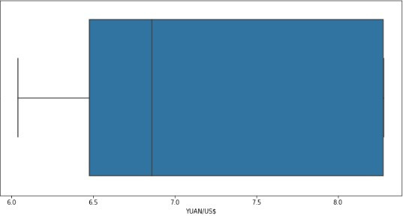
EXPLORATORY DATA ANALYSIS
Linearity
No outliers as shown in the boxplot diagram

Slide 11
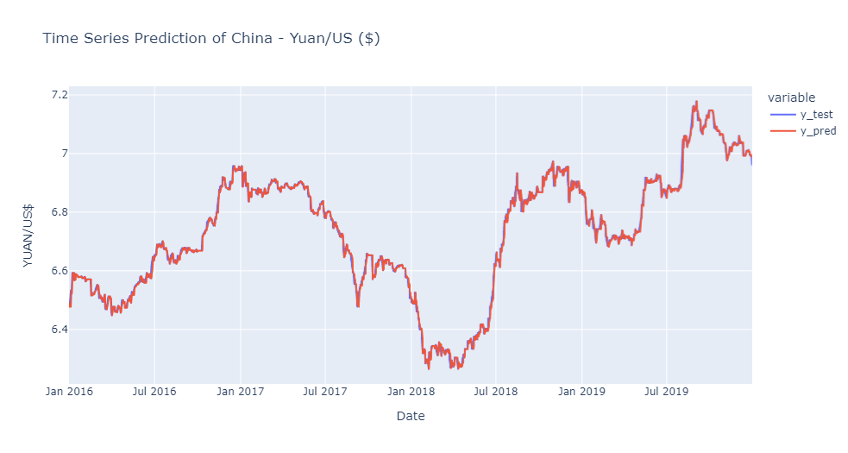
LINEAR REGRESSION
Performance Metrics
MAE: 0.010836
RSS: 0.27367
RMSE: 0.016191
r2_SCORE: 0.994079
Manager

Slide 12
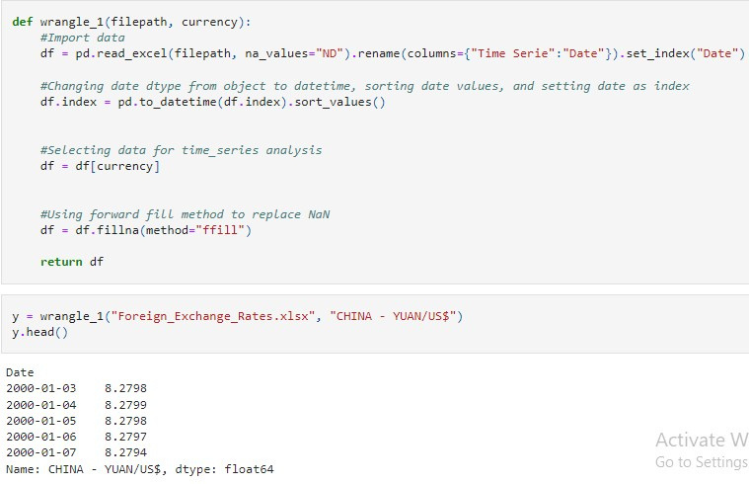
DATA WRANGLING (AR & ARIMA)

Slide 13
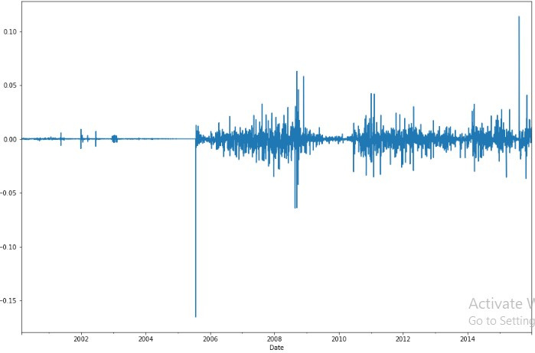
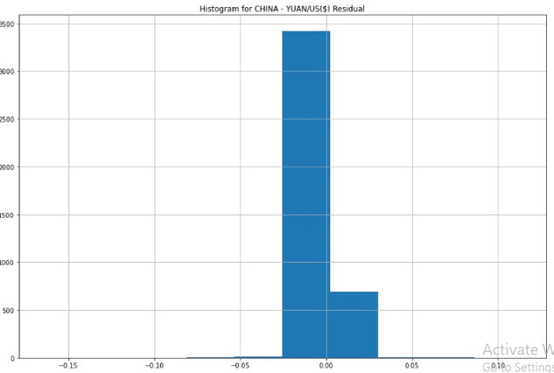
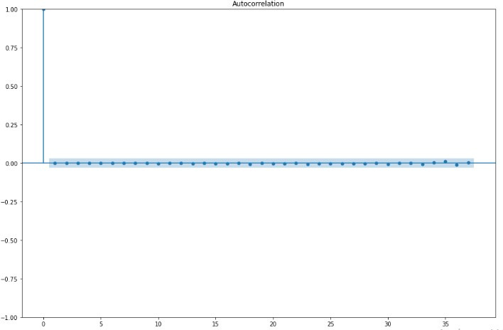
AUTOREGRESSIVE MODEL
From the visuals, it's deduced that:
The standard residuals has an upward and downward movement showing stationarity.
Our histogram plot follows a normal distribution.
The autocorellation has no predictive strength when p=35
Manager

Slide 14
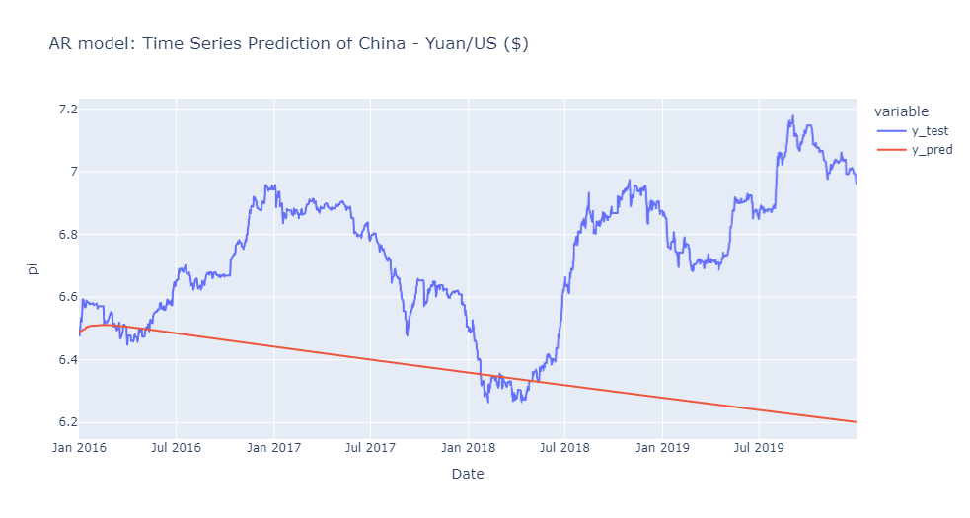
AUTOREGRESSIVE MODEL
Performance Metrics
MAE: 0.37504
Manager

Slide 15
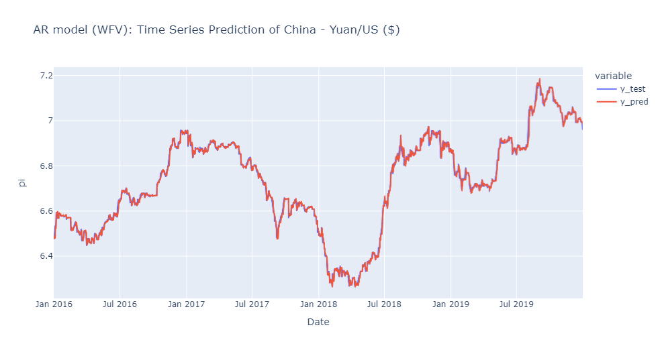
AUTOREGRESSIVE MODEL
Walk-Forward Validation
Performance Metrics
MAE: 0.01098
RSS: 0.274814
RMSE: 0.016224
r2_SCORE: 0.994054
Manager

Slide 16
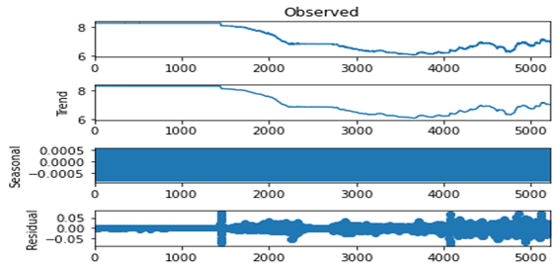
ARIMA MODEL
Manager

Slide 17
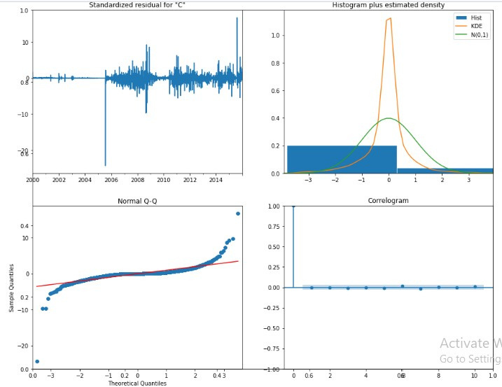
ARIMA MODEL
From the diagram, it's deduced that:
The standard residuals has an upward and downward movement.
Our histogram plot follows a normal distribution.
The correlation has no predictive strength when (p, 0, q) = (5, 0, 0)
Manager

Slide 18
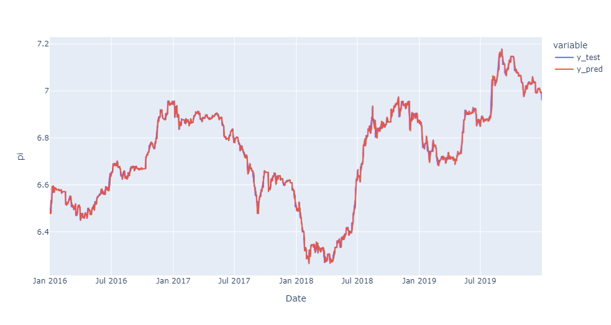
ARIMA MODEL
Walk-Forward Validation
Performance Metrics
MAE: 0.01080
RSS: 0.27330
RMSE: 0.01620
r2_SCORE: 0.99410
Manager

Slide 19
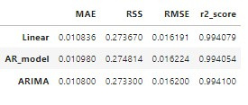
MODEL RESULT
Although ARIMA had a slightly better performance than linear regression (in terms of MAE); however, due to it high run time, linear regression is selected for use for a faster prediction.

Slide 20
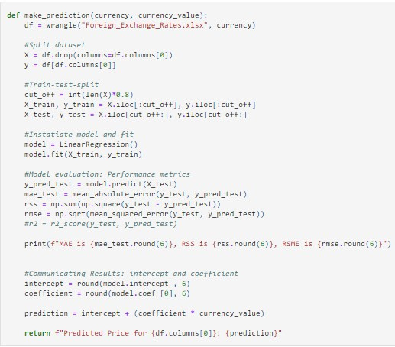
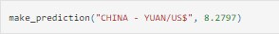
MODEL INFERENCE

Slide 21
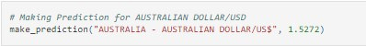
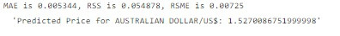
MODEL INFERENCE
Using our model to predict other currency

Slide 22
SUMMARY AND CHALLENGES
At the end of the project, our team was able to develop a linear regression model that can reliably predict the exchange rate value of any currency based on the data using the make_prediction function.
However, due to a variety of factors that influence foreign currency rates, such as political events, economic issues, inflation, market sentiment, and even war, a sudden rise or fall in the rate may occur, affecting the accuracy(ies) of the projection.
Furthermore, the presence of missing values, discrepancies, or inaccuracies may impair the prediction's accuracy.

Slide 23

PROJECT LINKS
The links below provide access to additional details of the project:
https://github.com/Dotzyman/Tensorflow-Capstone
Canva
Foreign Exchange Prediction Article by Team Tensorflow

